Slide 1

K-Nearest Neighbors (KNN) Model Analysis
This presentation explores the development and evaluation of a K-Nearest Neighbors (KNN) model for predicting whether a molecule is mutagenic based on its molecular descriptors. We'll delve into the data preprocessing, feature selection, hyperparameter optimization, model performance, and insights gained from the analysis.
Apurva
230180

Slide 2
Methodology
Data Preprocessing
Model Training
The dataset underwent a series of preprocessing steps to prepare it for model training. These steps included handling missing values, removing irrelevant columns, and scaling numerical features.
The preprocessed data was used to train a KNN classification model. Hyperparameters were tuned to optimize model performance, including the number of neighbors (k), distance weighting, and distance metric.

Slide 3

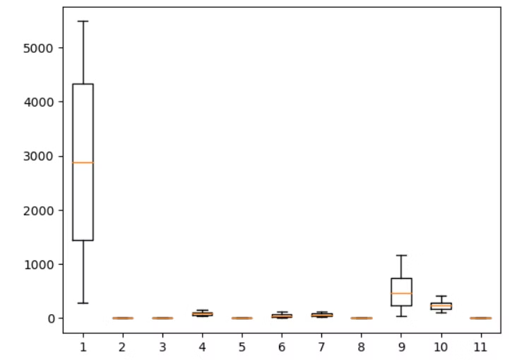
Data Preprocessing
Dataset Overview
Feature Engineering
The dataset contained properties of chemical compounds with missing values addressed through quantile clipping. Columns like 'CAS', 'SMILES', and 'Status' were dropped as they weren't relevant for prediction. 'Experimental value' was designated as the target variable.
Quantile clipping was applied to reduce the influence of outliers. A correlation heatmap visualized feature relationships. Standardization was performed using StandardScaler to normalize features.

Slide 4

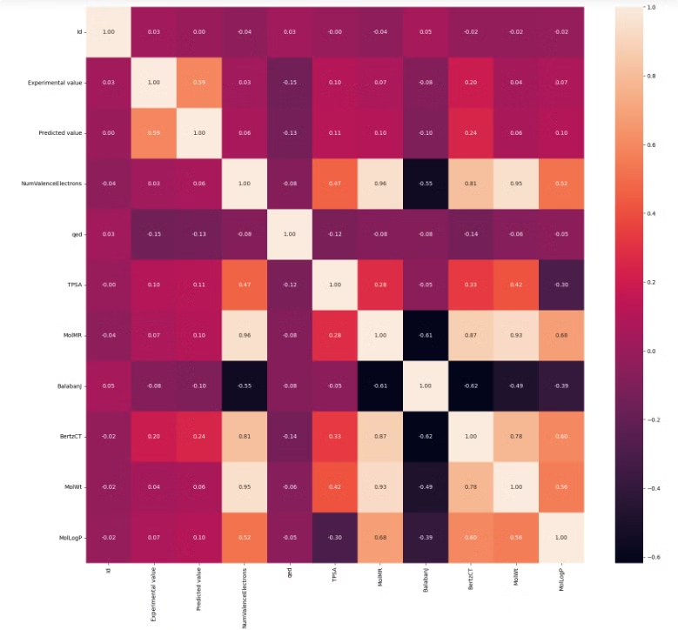
Feature Selection
1
Molecular Properties
2
Outlier Transformation
Features like 'MolWt', 'TPSA', and 'BertzCT' were selected for model training.
Outlier-prone features were transformed using logarithmic scaling when necessary.
3
Final Feature Set
After dropping identifiers and highly correlated attributes, the final feature set consisted of 7 features.

Slide 5
Hyperparameter Optimization
Number of Neighbors (k)
Distance Weighting
Distance Metric
Cross-Validation
Inverse-distance weighting was used to give closer neighbors more influence on predictions.
Euclidean distance was chosen for calculating the distance between data points.
5-fold cross-validation was used to assess the model's robustness and generalize its performance.
After experimentation, k was set to 9, a balance between accuracy and generalization.

Slide 6

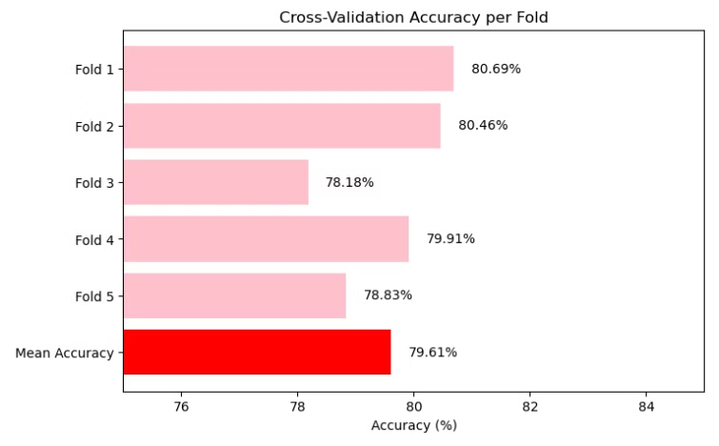
Cross-Validation Results
Fold
Accuracy
1
80.69%
2
80.46%
3
78.18%
4
79.91%
5
78.83%
Mean Accuracy
79.61%

Slide 7


Model Evaluation
Accuracy
F1 Score
79.60%
82.24%

Slide 8
Detailed Evaluation
Classification Report
Confusion Matrix
Class
Precision
Recall
F1-Score
Support
Predicted 0
Predicted 1
Actual 0
373
128
0
78%
74%
76%
501
Actual 1
107
544
1
81%
84%
82%
651
Overall Accuracy
79.60%

Slide 9
Findings & Insights
1
Strong Performance
2
Misclassifications
The model showed strong predictive capabilities, achieving high recall for Class 1, meaning it successfully identified most positive cases.
The confusion matrix indicated some misclassifications, particularly for Class 0, suggesting potential overlap in feature space.
3
Impact of Preprocessing
4
Future Improvements
Feature engineering and preprocessing played a crucial role in improving the model's performance and accuracy.
Potential improvements include fine-tuning k-values, exploring alternative distance metrics, and experimenting with ensemble methods.

Slide 10

Conclusion
The KNN model demonstrated strong predictive capability for experimental chemical property classification, achieving an accuracy of 79.6% and an F1 score of 82.24%. Future research could explore alternative classifiers, feature extraction techniques, and hyperparameter tuning to further enhance the model's performance and generalize its predictive capabilities.

